Slide 1

Semister Project
Name Of Student | PRN
Baviskar Khushal Gajanan | 231102073
Patil Nikhil Kishor | 231102085
Om Sanjay Navarkar | 231102098
Mali Rohit Valmik | 231102107
Topics
Digital Clock
Alcohol Detector
Vehical Accident Control

Slide 2
Alcohol Detector
• Introduction : An alcohol detector device is a sophisticated tool designed to quickly and accurately measure blood alcohol content (BAC) from a breath sample. It helps ensure safety by providing immediate feedback on alcohol levels, making it valuable for personal use, workplace safety, and law enforcement applications.
Literature Survey : Alcohol detectors use various sensors to detect the presence of alcohol. The most commonly used sensors are:
MQ-3 sensor: This sensor is highly sensitive to alcohol and can detect concentrations as low as 0.05 mg/L.
MQ-135 sensor: This sensor is sensitive to a wide range of gases, including alcohol, and can detect concentrations as low as 10 ppm.
TGS2620 sensor: This sensor is highly sensitive to alcohol and can detect concentrations as low as 1 ppm.
Previous studies have shown that Arduino-based alcohol detectors are effective and cost-efficient. For example, a study by [1] used an Arduino board with an MQ-3 sensor to detect alcohol concentrations in breath samples.

Slide 3
Implementation Details :
The alcohol detector designed in this project uses an Arduino Uno board, an MQ-3 sensor, and an LCD display. The MQ-3 sensor is connected to the analog input pin of the Arduino board, and the LCD display is connected to the digital output pins. The sensor detects the presence of alcohol and sends an analog signal to the Arduino board, which then displays the concentration of alcohol on the LCD display.
The circuit diagram is as follows:
MQ-3 sensor -> Arduino Uno -> LCD display
| | |
| | |
V V V
Analog input Digital output Digital output
Project Outcomes :
The alcohol detector designed in this project is able to detect alcohol concentrations as low as 0.05 mg/L. The device is simple, cost-effective, and easy to use. The results of the project are as follows:
The device is able to detect alcohol concentrations accurately.
The device is able to display the concentration of alcohol on the LCD display.
The device is simple and cost-effective.

Slide 4
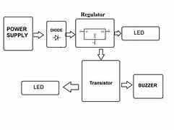
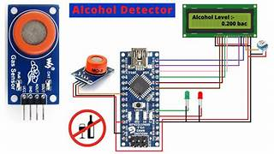
Circuit Diagram
Block Diagram
Conclusion :
In conclusion, the alcohol detector designed in this project is a simple and cost-effective device that can detect alcohol concentrations accurately. The device has many potential applications, including in law enforcement agencies and industries where workers are required to operate heavy machinery.

Slide 5
Vehicle Accident Control
Introduction : Vehicle accidents have become a major concern in today's world, resulting in a significant number of deaths and injuries. The need for a system that can detect and prevent accidents has become increasingly important. This project aims to design and develop a Vehicle Accident Control system that can detect accidents and alert the authorities in real-time.
Literature Survey : Several studies have been conducted on vehicle accident detection and prevention systems. According to , the use of sensors and GPS technology can help detect accidents and alert the authorities. Another study suggests that the use of machine learning algorithms can improve the accuracy of accident detection.
Implementation Details : The Vehicle Accident Control system consists of the following components:
Sensors: Accelerometers and GPS sensors are used to detect accidents.
Microcontroller: The microcontroller is used to process the data from the sensors and detect accidents.
GSM Module: The GSM module is used to send alerts to the authorities in real-time.
Machine Learning Algorithm: A machine learning algorithm is used to improve the accuracy of accident detection.
The system is implemented using the following steps:
Data collection: Data is collected from the sensors and GPS module.
Data processing: The data is processed using the microcontroller.
Accident detection: The machine learning algorithm is used to detect accidents.
Alert system: The GSM module is used to send alerts to the authorities.

Slide 6
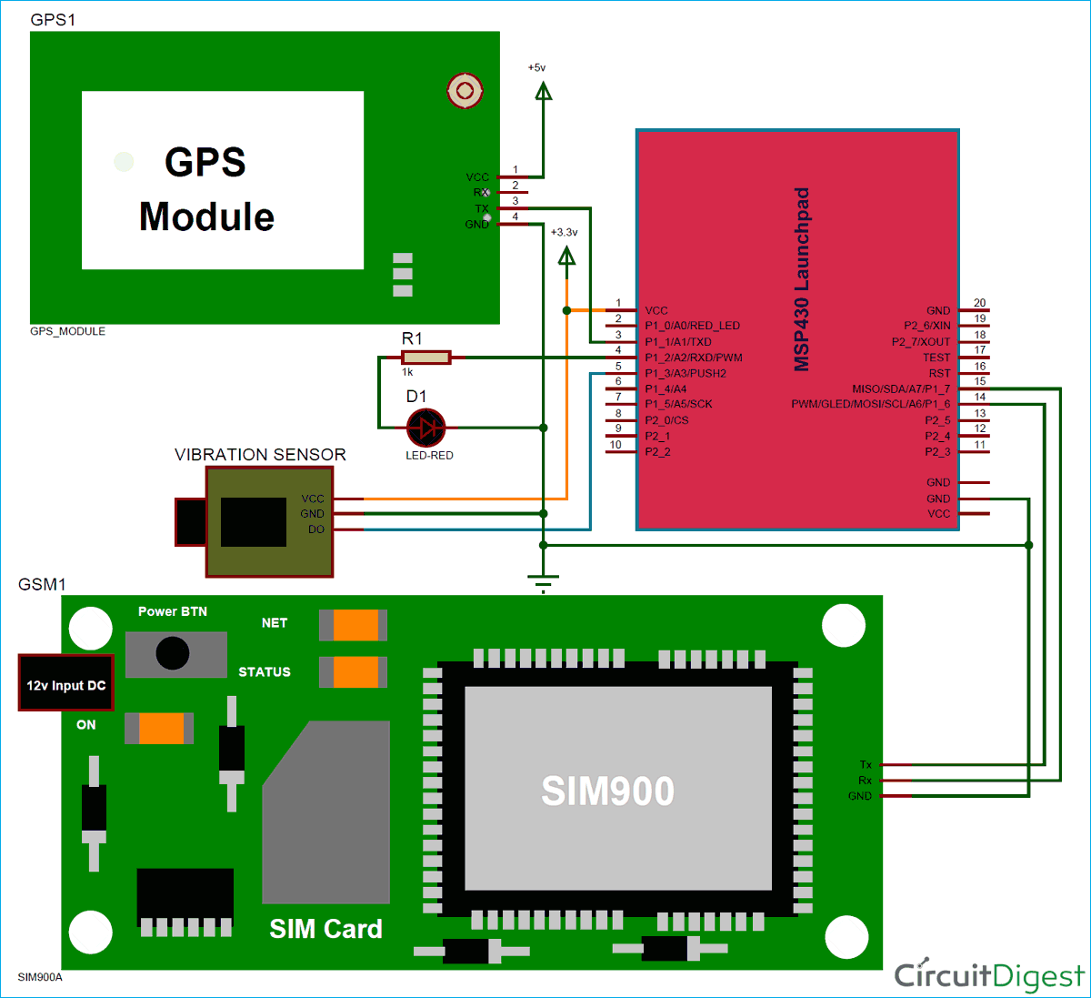
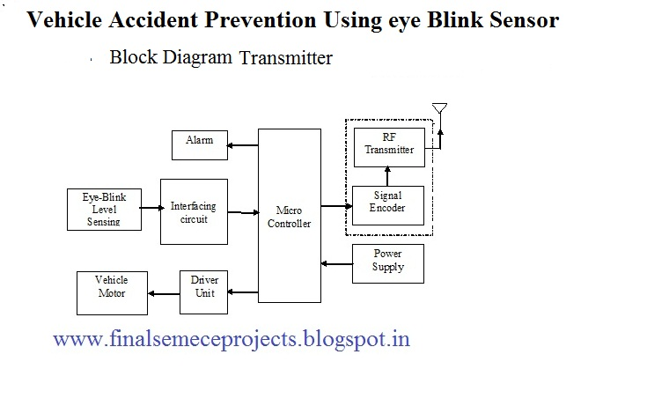
Project Outcomes : The Vehicle Accident Control system has several outcomes, including:
Improved safety: The system can detect accidents and alert the authorities in real-time, improving safety on the roads.
Reduced response time: The system can reduce the response time of the authorities, resulting in faster medical assistance and reduced damage.
Cost-effective: The system is cost-effective and can be implemented in vehicles of all types.
Circuit Diagram
Block Diagram

Slide 7
Conclusion : The Vehicle Accident Control system is a comprehensive system that can detect accidents and alert the authorities in real-time. The system has several outcomes, including improved safety, reduced response time, and cost-effectiveness. The system can be implemented in vehicles of all types, making it a viable solution for reducing accidents on the roads.

